Slide 1
Introduction to Object-Oriented Programming
Lecturer: Jay A. Abaleta

Slide 2
What is OOP?
Object Oriented programming is a programming style which is associated with the concepts like class, object, Inheritance, Encapsulation, Abstraction, Polymorphism.
Traditional procedural-oriented programming languages (such as C, Fortran, Cobol and Pascal) suffer some notable drawbacks in creating reusable software components.
- Functions are less reusable.

Slide 3
OOP – Stands for Object-Oriented Programming
Procedural programming is about writing procedures or methods that perform operations on the data, while object-oriented programming is about creating objects that contain both data and methods.
Object-oriented programming has several advantages compare to procedural programming.

Slide 4
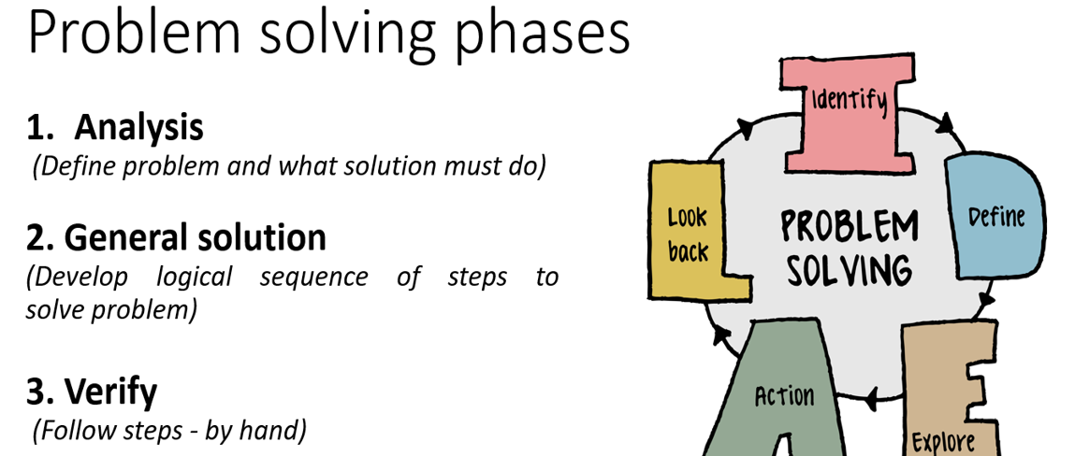
Write the Source Code

Slide 5
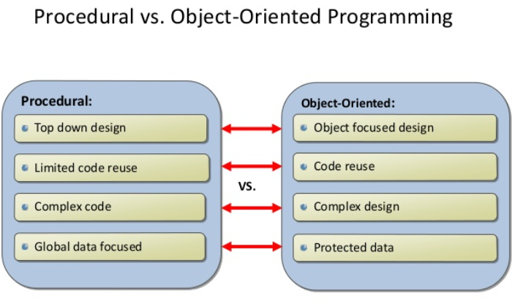

Slide 6
Advantages of OOP
OOP is faster and easier to execute.
It provides clear structure for the programs.
Help us to keep the Java code DRY “Don’t Repeat Yourself”, and makes the code easier to maintain, modify and debug.
Note: The “Don’t Repeat Yourself (DRY)” principle is about reducing the repetition of code. You should extract out the codes that are common for the application and place them at a single place and reuse them instead of repeating it.
OOP makes it possible to create full reusable applications with less code and shorter development time.

Slide 7
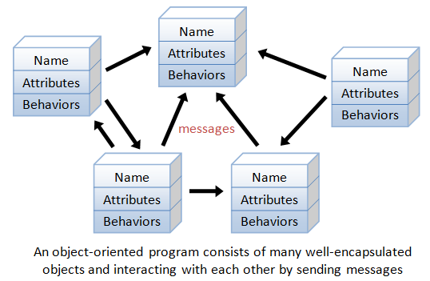
Object-Oriented Programming Languages
The basic unit of OOP is a class, which encapsulates both the static properties and dynamic operations within a "box" and specifies the public interface for using these boxes.

Slide 8
What are Classes and Objects?
Classes and objects are the two main aspects of object-oriented programming.
Look at the following illustration shown in the next slides to see the difference between class and objects.

Slide 9
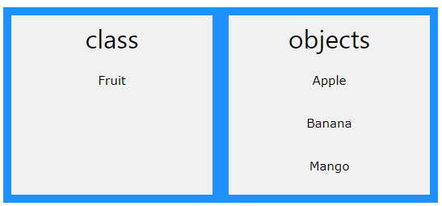
Classes and Objects

Slide 10
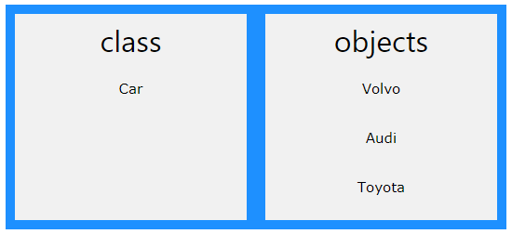
Classes and Objects

Slide 11
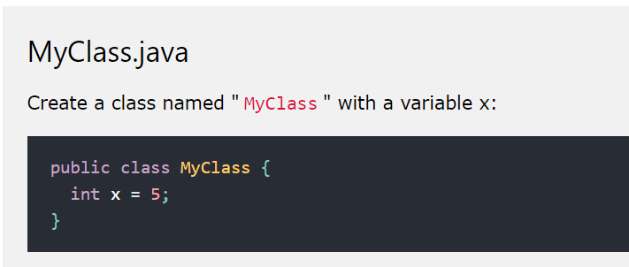
Java – What are Classes and Objects?
Class – is like an object constructor, or a “blueprint” for creating objects.
To create a class, use the keyword class:

Slide 12
Java – What are Classes and Objects?
Object – In Java, an object is created from a class. Continuing with the example awhile ago we created the class named MyClass, so now we can use this to create objects.
To create an object of Myclass, specify the class name, followed by the object name, and use the keyword new:

Slide 13
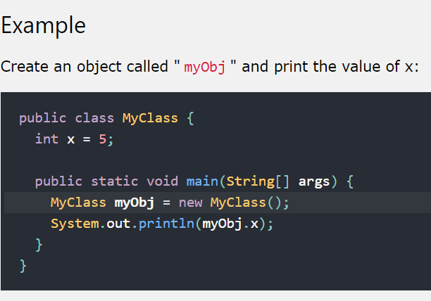
Java – What are Classes and Objects?

Slide 14
Classes and Objects (Real World)
Person ​
Name ​
Gender ​
Weight ​
# jowa so far ​

Slide 15
Representation in Code
// person Jhersell ​
String nameJhersell; ​
double weightJhersell; ​
// person david ​
String nameLady; ​
double weightLady; ​
// Add more person
BAD CODE
What if there are 3 person named Jhersell, Lady and…?

Slide 16
With objects and classes …
You can use the existing class created.​
You can create a new object.​
Person alex = new Person();​
Person david = new Person();​
Person otherPeople = new Person();
​
​

Slide 17
Classes and Objects (Real World)
Person​
String Name ​
String Gender ​
double Weight ​
int numOfCars ​
​

Slide 18
PERSON
CLASS - Person
String Name ​
String Gender ​
double Weight ​
int numOfJowa ​
INSTANTIATE
OBJECT​

Slide 19
Creating objects and classes
Declaration − A variable declaration with a variable name with an object type.​
Instantiation − The 'new' keyword is used to create the object.​
Initialization − The 'new' keyword is followed by a call to a constructor. This call initializes the new object.
​
​

Slide 20
PERSON
CLASS
Person​
String Name ​
​
OBJECT
Jay
​
INSTANTIATE

Slide 21
PERSON
CLASS
Person​
String Name ​
​
OBJECT
Jhersell
​
INSTANTIATE
OBJECT
Lady
​
OBJECT
OtherPeople
​
Notes:
CLASS – is going to be defined inside of a FILE.
OBJECT – is going to be created as variables

Slide 22
PERSON
CLASS
Person​
String Name ​
​
OBJECT
Jay
​
INSTANTIATE
OBJECT
John
​
Person x
OBJECT
David
​

Slide 23
PERSON
CLASS
Person​
String Name ​
​
OBJECT
Jay
​
INSTANTIATE
OBJECT
John
​
Person x
OBJECT
David
​
identifier

Slide 24
PERSON
CLASS
Person​
String Name ​
​
OBJECT
Jay
​
INSTANTIATE
OBJECT
John
​
Person x
OBJECT
David
​
Custom
type
identifier

Slide 25
PUBLIC x PRIVATE
CLASS
Person​
String Name ​
​
me.name = “Angelique”;
another.name = “John”;

Slide 26
Object-Oriented Programming Languages
OP languages permit higher level of abstraction for solving real-life problems.

Slide 27
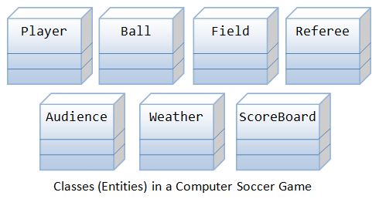
Object-Oriented Programming Languages
Example:
using OOP languages, you can easily model the program accordingly to the "real things" appear in the soccer games.
Can be used in another application:
Basketball game

Slide 28
Benefits:
Ease in software design
Ease in software maintenance:
Reusable software:
Notes:
Benefits of OOP
The procedural-oriented languages focus on procedures, with function as the basic unit. You need to first figure out all the functions and then think about how to represent data.
The object-oriented languages focus on components that the user perceives, with objects as the basic unit. You figure out all the objects by putting all the data and operations that describe the user's interaction with the data.
Object-Oriented technology has many benefits:
Ease in software design as you could think in the problem space rather than the machine's bits and bytes. You are dealing with high-level concepts and abstractions. Ease in design leads to more productive software development.
Ease in software maintenance: object-oriented software are easier to understand, therefore easier to test, debug, and maintain.
Reusable software: you don't need to keep re-inventing the wheels and re-write the same functions for different situations. The fastest and safest way of developing a new application is to reuse existing codes - fully tested and proven codes.

Slide 29
Class and Instances
In Java, a class is a definition of objects of the same kind. it is a blueprint, template, or prototype that defines and describes the static attributes and dynamic behaviors common to all objects of the same kind.
An instance is a realization of a particular item of a class. In other words, an instance is an instantiation of a class.
The term "object" usually refers to instance.

Slide 30
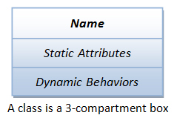
A Class is a 3-Compartment Box Encapsulating Data and Operations
Name (or identity): identifies the class.
Variables (or attribute, state, field): contains the static attributes of the class.
Methods (or behaviors, function, operation): contains the dynamic behaviors of the class.

Slide 31
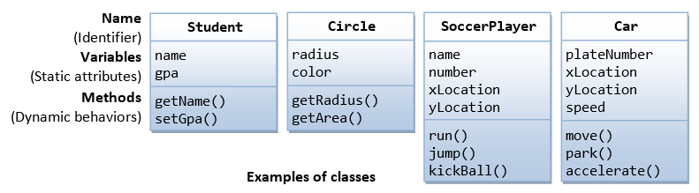
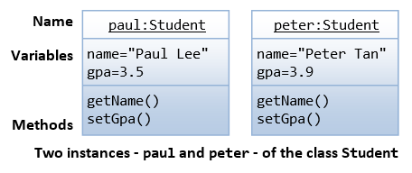
Example

Slide 32
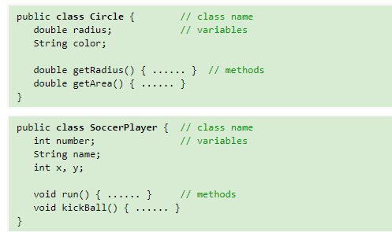
Example

Slide 33
Creating a Class
3 Parts
An optional access modifier
The keyword class
Any legal identifier you chose for the name of your class
public class Employee

Slide 34
Creating a Class
Application classes frequently instantiate objects that use the objects of other classes (and their data and methods). Sometimes you write classes that do both.
Contains public static void main(). The main() method is the starting point for any application.
You can call an application or class that instantiates objects of another prewritten class a class client or class user.

Slide 35
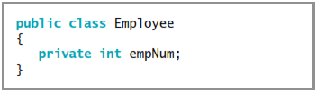
Creating a Class (example)
A nonstatic field like empNum is an instance variable for the class.

Slide 36
Creating a Class (example)
Assigning private access to a field means that no other classes can access the field’s values, and only methods of the same class are allowed to set, get, or otherwise use private variables.
The principle used in creating private access is sometimes called information hiding

